Slide 1




Driving value from user opinion
Web Data Analytics Project
Team 9
Kim Jaemin
Lakshay Vohra
Mrinmayee Joshi
Manideep Sharma

Slide 2

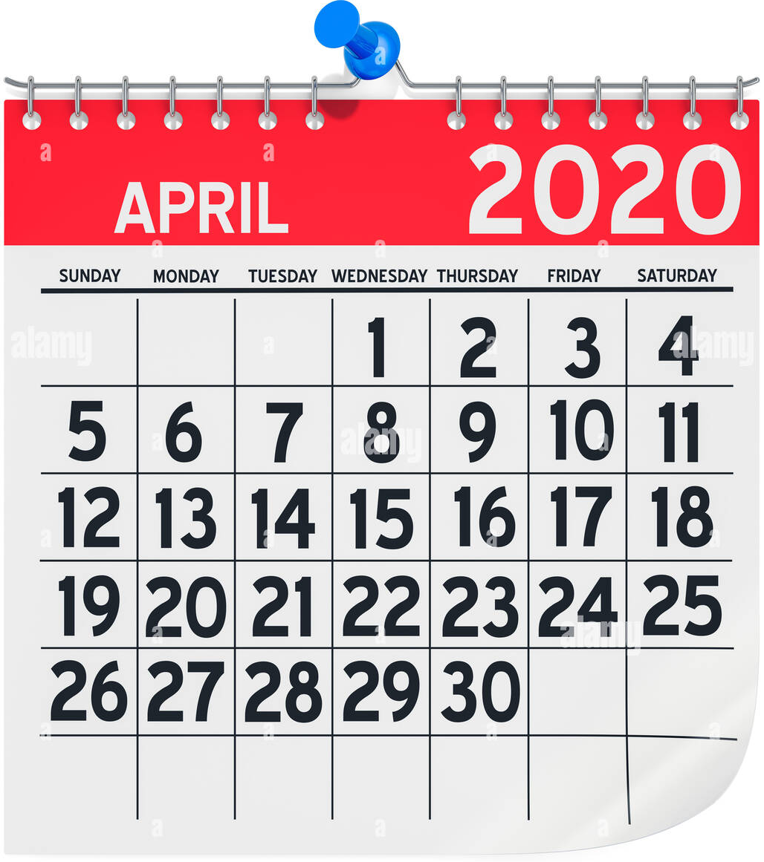
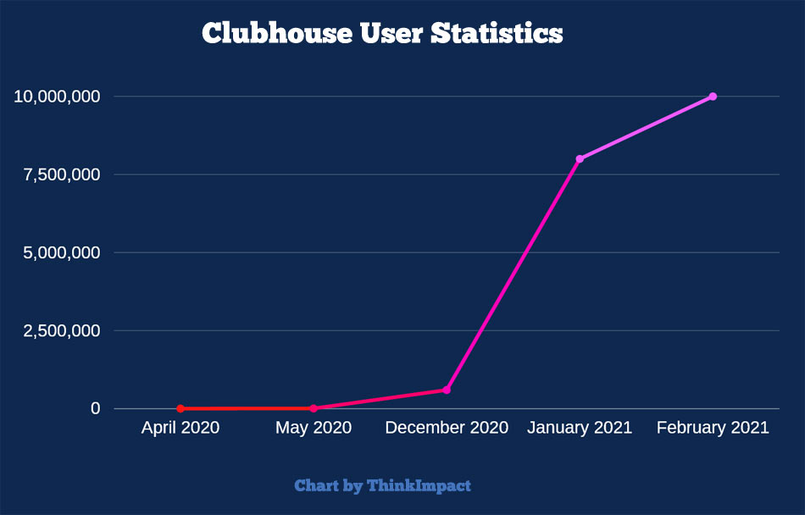
What is Clubhouse?
Launch
Weekly active user
App usage hours
Market Value
10M
11~22
hour /
week
May 2020
Feb 2021
10M
7.5M
5M
2.5M
0
$1B
Apr. May Dec. Jan. Feb.
2020 2020 2020 2021 2021
Jan 2021

Slide 3
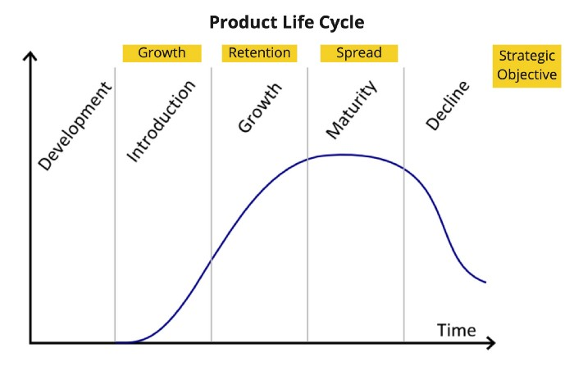
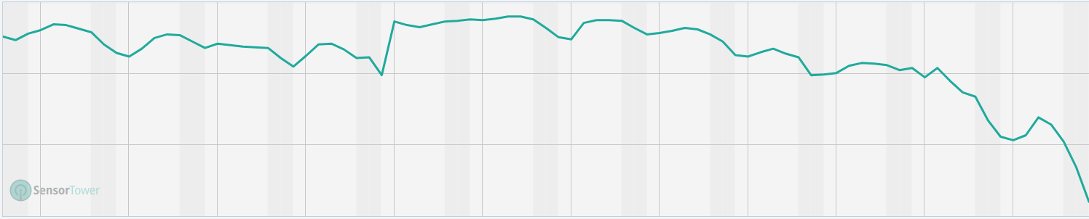

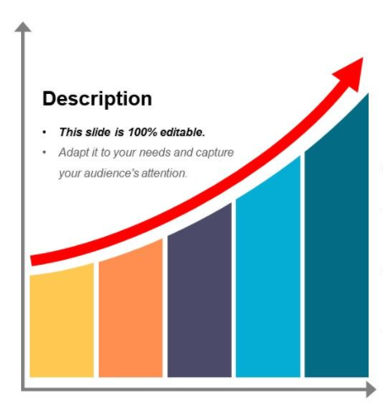
Business Goal & Challenge
Clubhouse's business stage
iOS daily category app ranking
21
1
100
200
300
How to Keep Continuous
Growth?
280
Jan.
Feb.
Mar.

Slide 4


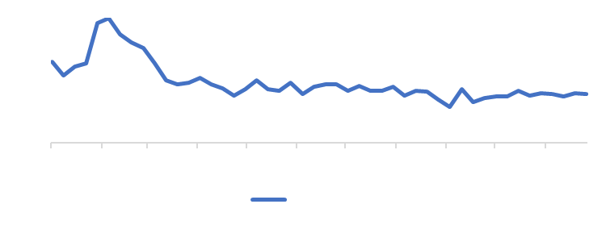



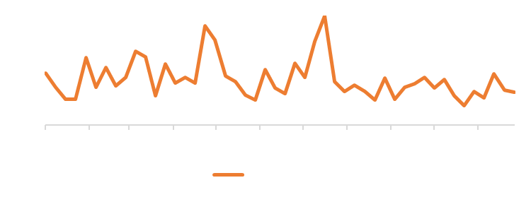
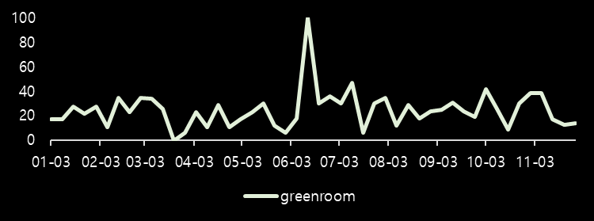
Competitor Risk
news scrapping :
# of articles mentioning competitors
trend scrapping :
keyword search

Slide 5
Business Questions and Approach
What are customers saying about Clubhouse?
Scrape reviews from Play Store
Have Clubhouse ratings improved significantly over time?
Review Analysis
Are app updates having an impact on user ratings?
T-test
Based on the Play Store reviews, what are the things that working for
Clubhouse and not working for Clubhouse?
LDA topic modelling

Slide 6
Clubhouse has been releasing regular app updates
App Launched
RSVP for events
Create a club
Send Payment to creators
New DM service
Removed Waitlist – Open and invite
Wave – Casual Conversation
Spatial (3D) audio
Lifelike experience
Introduce Local Language support
Replay
Aug
4.61
Nov
4.50
Sep
4.47
Oct
4.46
Jul
4.36
May
4.27
Jun
4.22
Add social media accounts to profile
Follow people
Get to Backchannel without leaving room
Search from Hallway
Pin Links to a room
Notes:
Here’s a bird’s eyeview of the change in ratings and app updates happening since the app was launched till date.
We can see that the ratings have increased till august but dropped down after that.

Slide 7

Hypothesis – Is the increase in app ratings significant?
H₀ : Null hypothesis
Frequent app-updates are not significantly increasing the ratings and users are talking about negative topics that the company should focus on upcoming updates.
H₁: Alternative hypothesis
With frequent app-updates in a given timeframe, average ratings are going higher, and it is worth investing money in frequent rollouts. Users are happy and talking about great features of Clubhouse

Slide 8
There is no significant increase in app ratings due to frequent updates
Is this increase significant?
Average Rating = 4.47
Results of t-test gave p-value = 0.683
Evidence is not sufficient to reject
null hypothesis
Counter-intuitive result:
App updates are not improving ratings!
Average Rating = 4.36
For credibility, only reviews with upvotes>0 were considered
Notes:
For credibility purpose we chose reviews which had number of upvotes > 1 and ran a t-test in minitab. T-test was applied to compare whether the average difference in rating between the periods May-Aug and Sept- Nov is significant or if it’s due to random chance. It helps to answer questions like whether the app-rating is higher after implementing multiple updates on the app. In this case the p-value=0.68, which meant we had no evidence to reject Null Hypothesis.

Slide 9

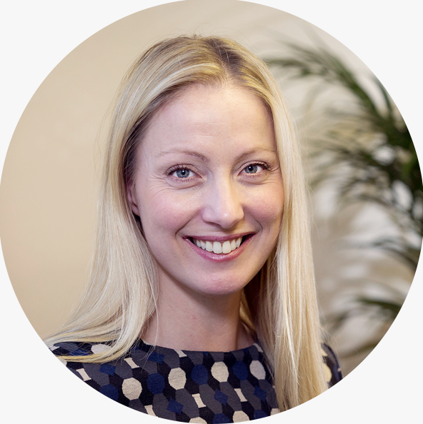



User opinion has evolved over time
..the voice quality
is great…
..great place to meet
interesting people…
+ve reviews
CH becomes
open to all
-ve reviews
..can’t connect my
Instagram account..
..how can I block the
adult chat rooms?..
..I don’t get recommended
the rooms I’m interested in…
* CH added Insta and Twitter
support Jun-21
* ~200 reviews complain about this
* ~150 reviews complain about this

Slide 10
Summarizing the user opinion
What is working?
What is not working?
Clubhouse has a strong community of
creators and hosts who are committed
to the platform
Several users have faced harassment
with people contacting them outside
of Clubhouse
Community
Privacy
Celebrities and experts in a wide variety
of fields are present and actively
contribute to Clubhouse
Number of ‘adult rooms’ is increasing,
encroaching on experience of users
not interested in them
Expertise
Content
Filtering
Users are generally happy with the platform
in terms of audio quality, and the features
that enable interaction between users
Many users have complained of poor
suggestions which has led to loss
of interest
Platform
Recommender
System

Slide 11

Recommendations and the way forward
d
Preserve Community
Better Recommendations
Engage and reward top content creators
and moderators to prevent important users from churning out of the platform.
Develop a strong recommender system that
can suggest rooms suitable to users’ interests
Automated content censorship
Take harassment cases seriously
Develop features to automatically detect
abusive content and flag it for review
Clubhouse should tackle the harassment
cases that happened on it’s platform and take constructive measures to improve brand image
Notes:
So now lets see some of the recommendations for clubhouse -
It can be seen from its past performance that various well known artists have come and joined the app which attracted attention of other users. It has continued to be a strong selling point for the app. Now in order to not lose such high value content creators, Clubhouse should keep them engaged and reward them accordingly
From the review analysis, one of the trending negative review that came up was that the clubhouse is recommending adult content or the content that the user is not interested even after the user has marked those content irrelevant to them. So it should work on its recommender system to generate more accurate results in order for users to not get frustrated because of weird recommendations
A lot of negative reviews were focused on presence of abusive content due to which users got disinterested in the app and left it. So Clubhouse can work on building a automated content censorship algorithm which can detect the abusive content automatically and flag it for further review
Some users have complained about the harassment on the app. So clubhouse can introduce some guidelines and take necessary actions against the harassment cases. Not doing so will create a lot of bad PR to the company

Slide 12


Limitations
Limited to user reviews coming from Google Play store only. Need to
explore other sources as well
Need to gauge user opinions/reviews for competitor apps to understand
where Clubhouse stands
Lack of granular data with details such as MAU (Monthly Active Users), actual app downloads for both iOS as well as Android
Reviews are limited to understanding details. Most of the reviews have
only ratings and text reviews are less.
Notes:
Now lets look into some of the limitation of our work in analysing Clubhouse business –
The reviews that we scraped were only from google play store. Other sources could also be explored to get user sentiments
Reviews for competitors can also be scraped and analysed for more robust understanding of where Clubhouse stands
There is a lack of longitudinal data for number of active users, downloads etc , which can further boost the analysis
Number of actual reviews were pretty low as compared to the number of ratings. i.e not many people have posted the reviews. So the results are only based on text reviews posted by the users.

Slide 13
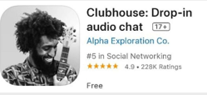
Appendix

Slide 14
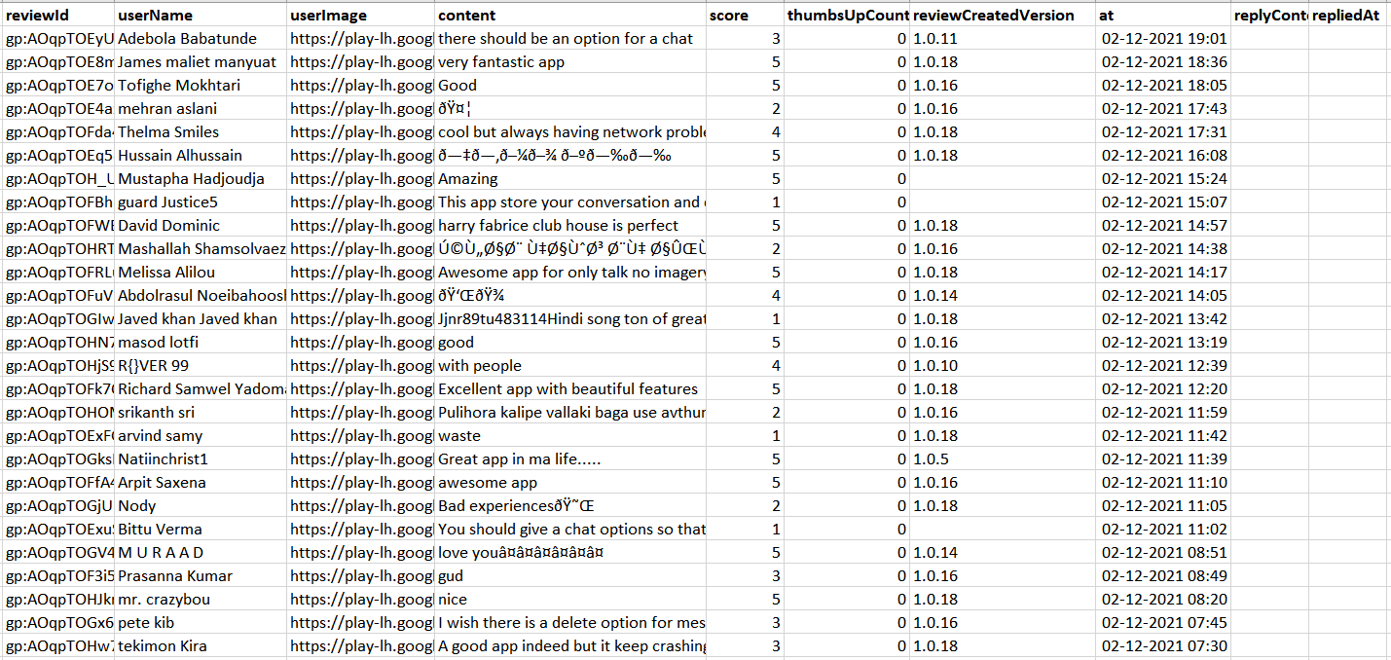
Data Scraped from Google Play Store

Slide 15
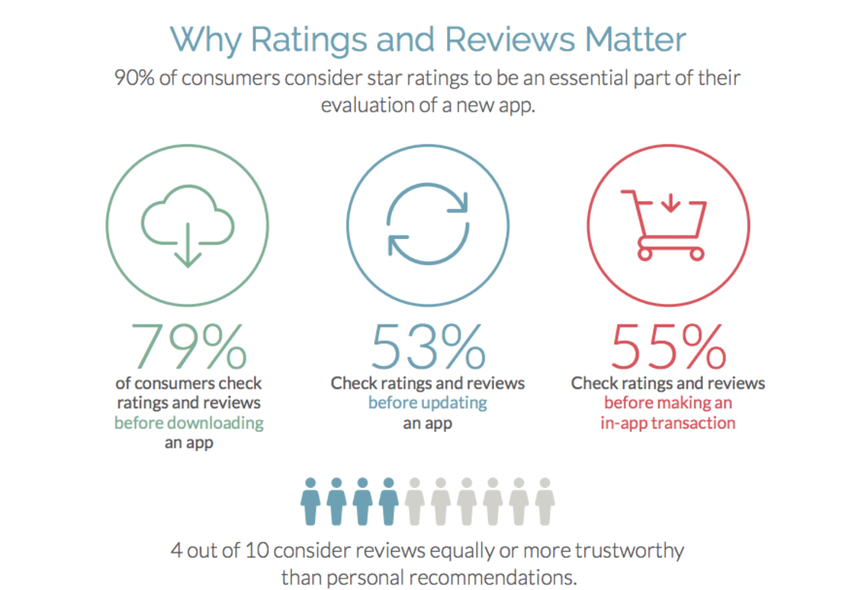
90% of users consider star ratings an essential part of their app evaluation
Source: https://thetool.io/2017/improve-user-ratings

Slide 16
Stats
~29,000
Total number of reviews scraped
~2,650
Reviews with >0 upvotes
Positive*
~1,200
Negative*
~1,450
Reviews based on ratings
*Positive: Reviews with 3 or more stars
Negative: Reviews with 2 or less stars

Slide 17
Negative ratings are more prevalent among reviews with higher number of upvotes

Slide 18
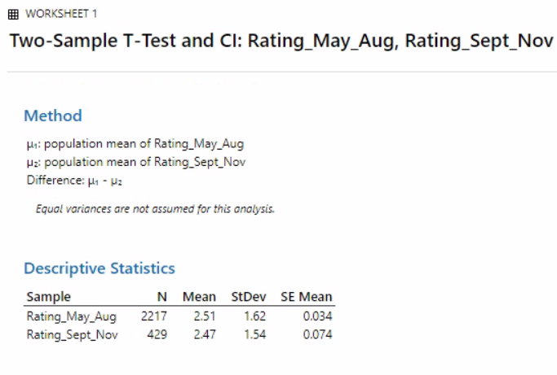
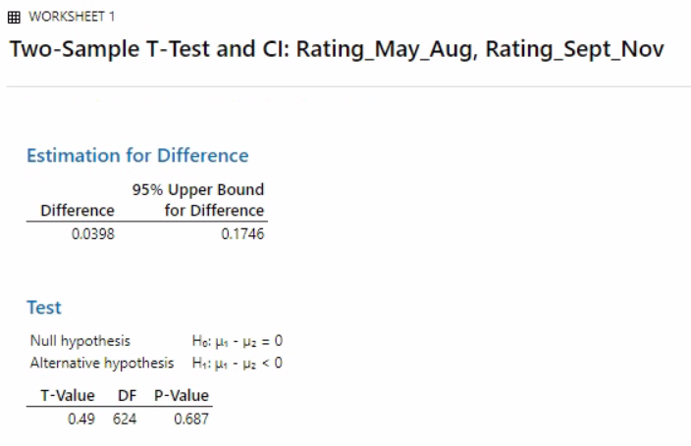
T-test Results

Slide 19
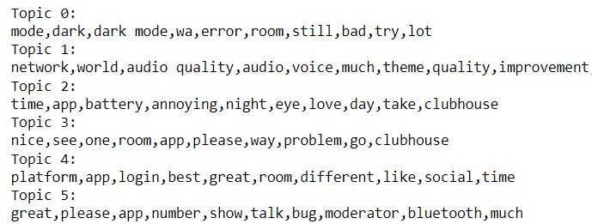
LDA Analysis
Filter reviews for the
required criteria
.
(e.g., # of reviews, # of upvotes, time
period etc.)
Tokenize, Lemmatize,
convert to TF-IDF
Perform LDA
.
Specify number of topics, number of identifiers within each topic
Interpret LDA results
Business Insights and
recommendations
Synthesize results

Slide 20
Comparison: Clubhouse vs Spaces vs Greenroom
 | Clubhouse | Spotify Greenroom | Twitter Spaces
Sensitive contents | There is no contents filtering | Violent, sexually explicit content are not allowed | Same as Clubhouse
Connecting with people | Search + contact list | Only by search | Same as Clubhouse
Add to calendar | Not supported | Supported | Supported
Homepage | Based on the people and groups you follow | Based on your interest | Same as Clubhouse
Backchannel | Supported | Not supported. You need to exit the existing room | Supported
Contents creator monetization | Available through Creator First Accelerator program | Not available yet | Available through Ticketed Spaces
Notes:
Add a line chart –
numbers

Slide 21
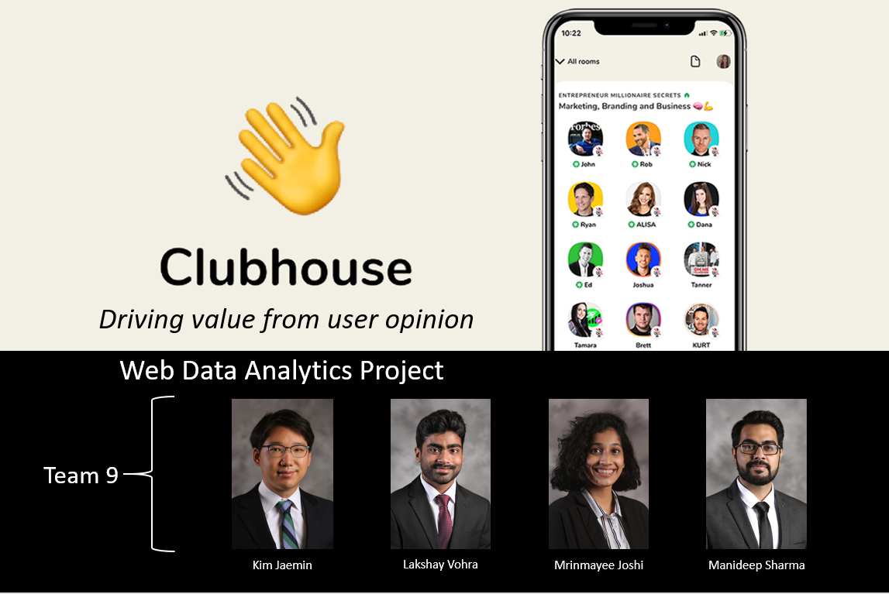

Slide 22
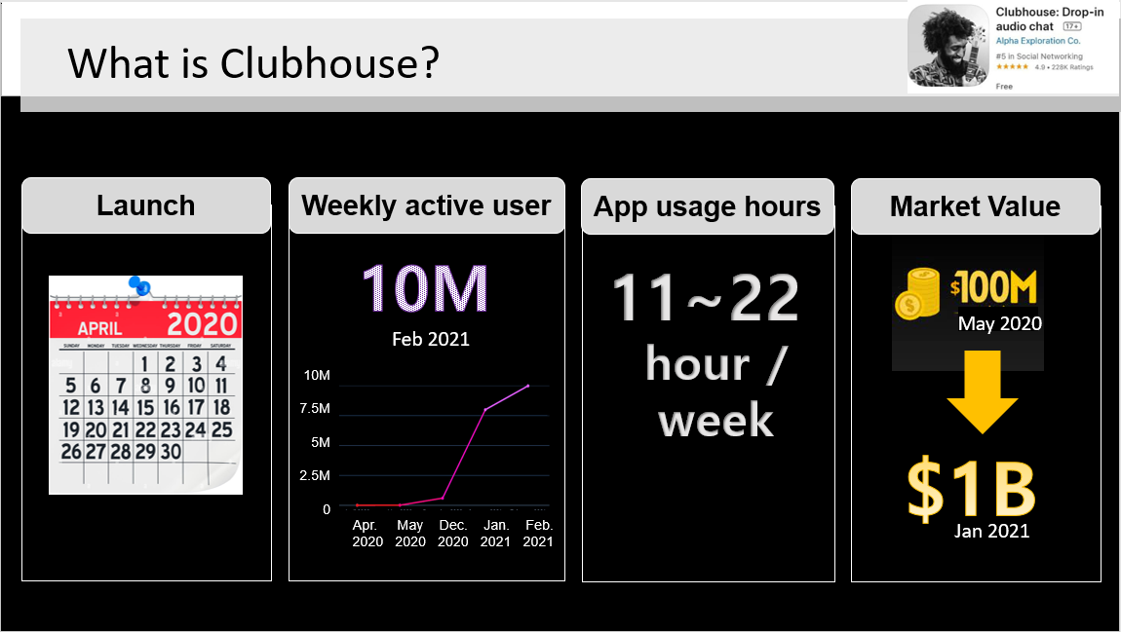

Slide 23
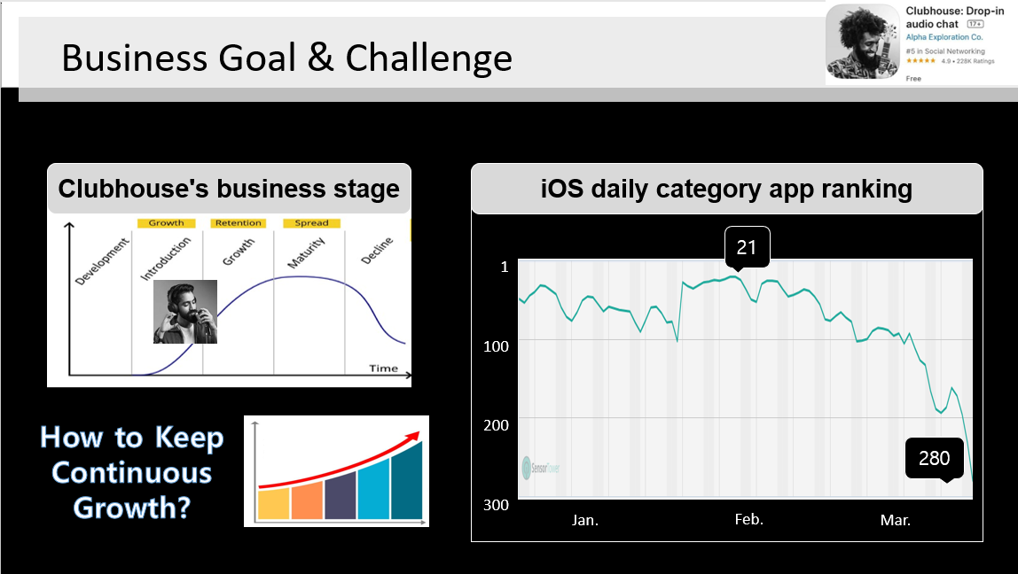

Slide 24
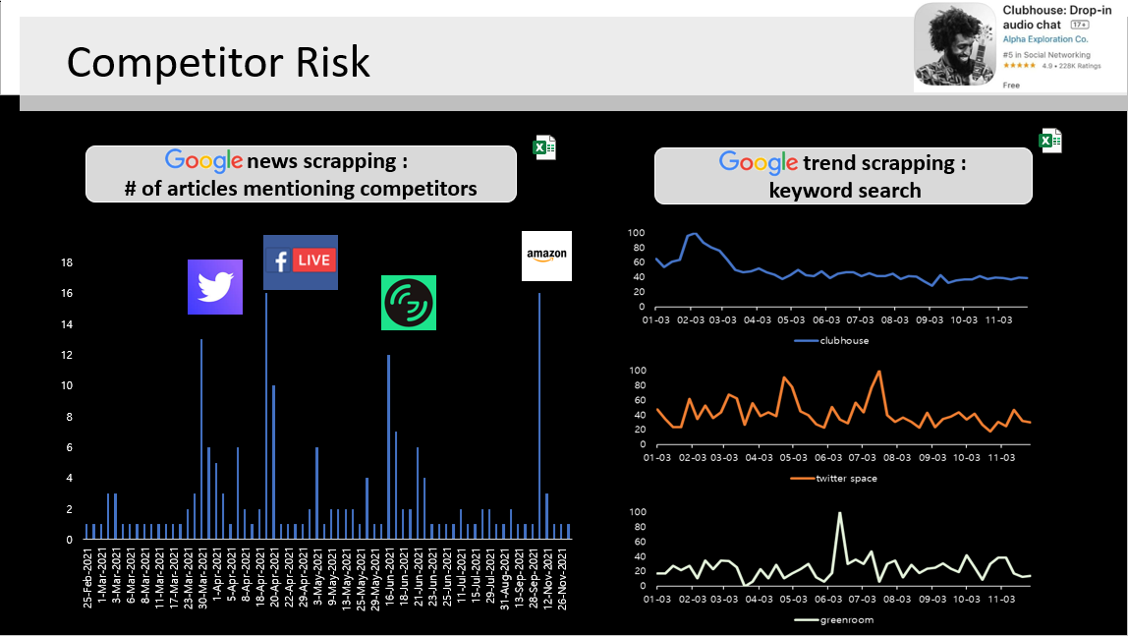

Slide 25
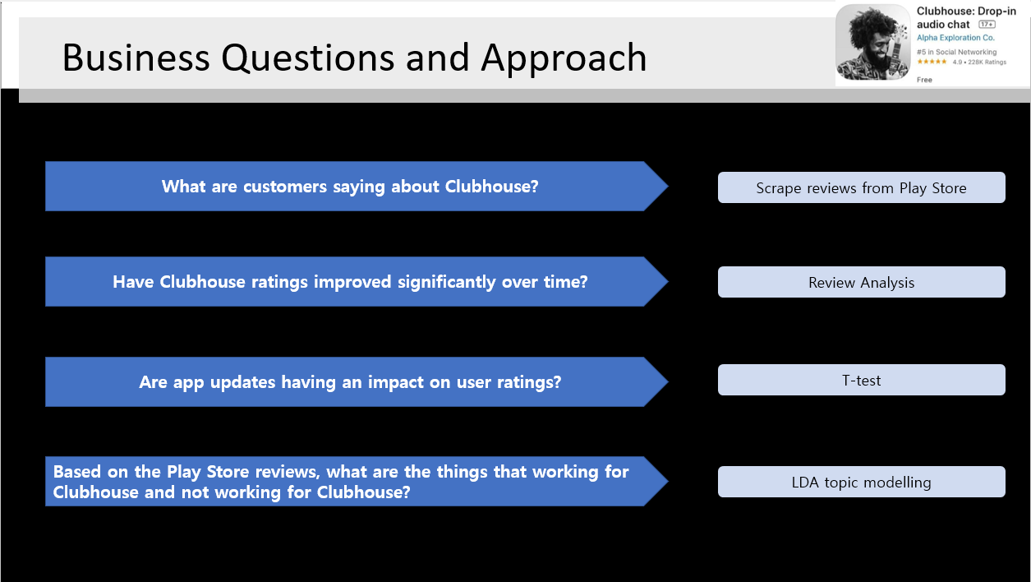

Slide 26
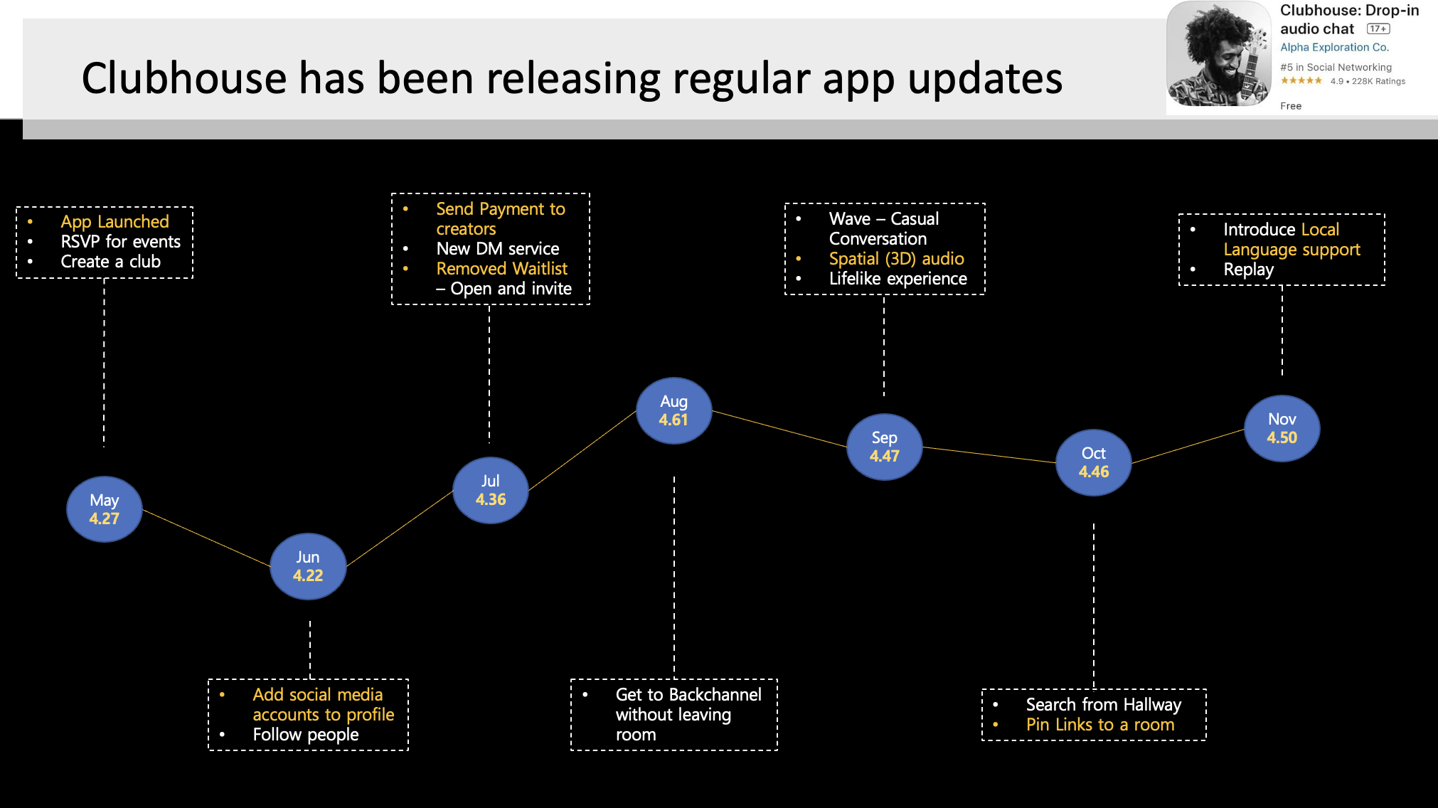

Slide 27
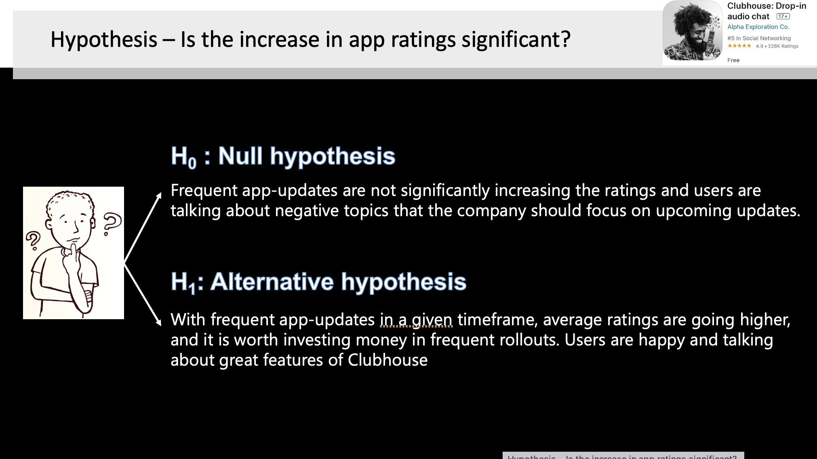

Slide 28
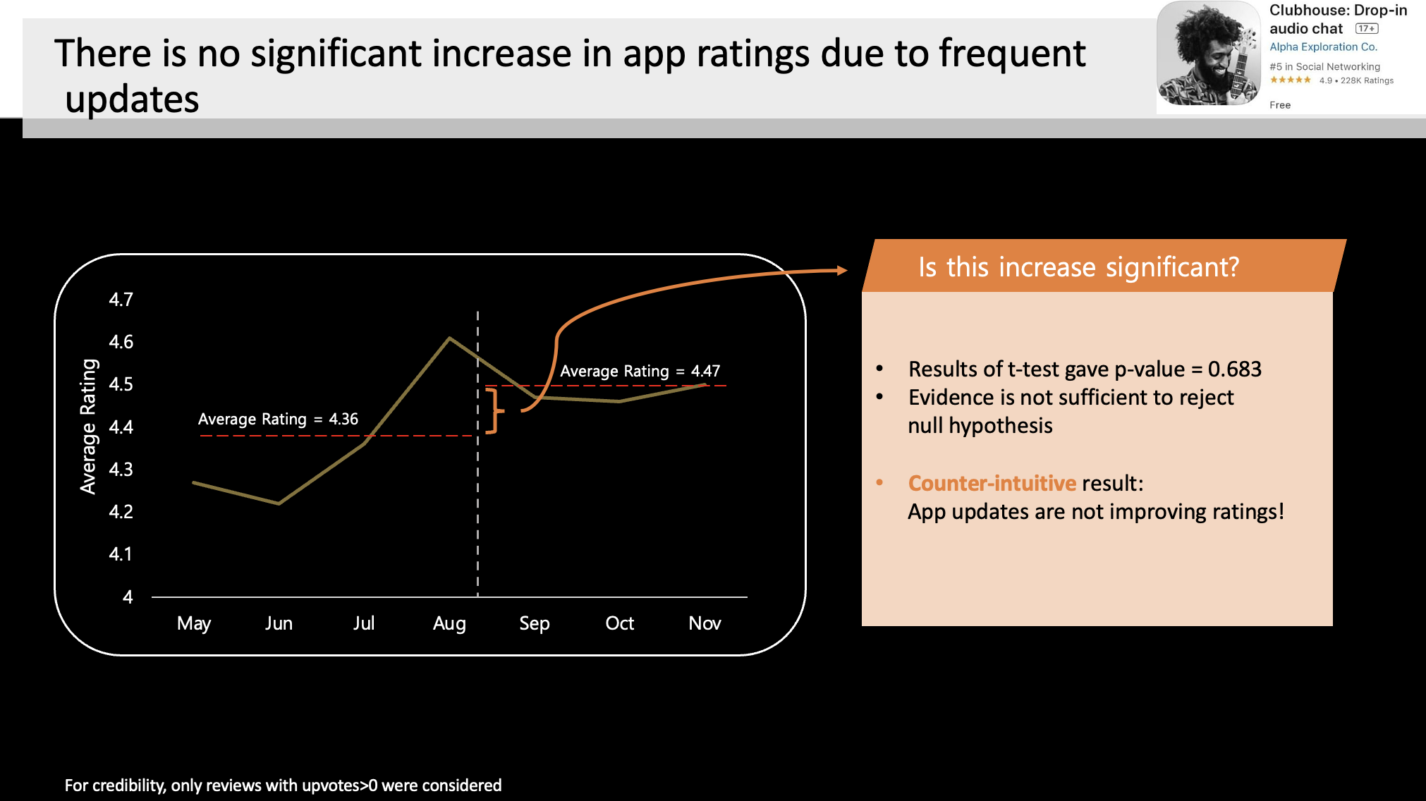

Slide 29
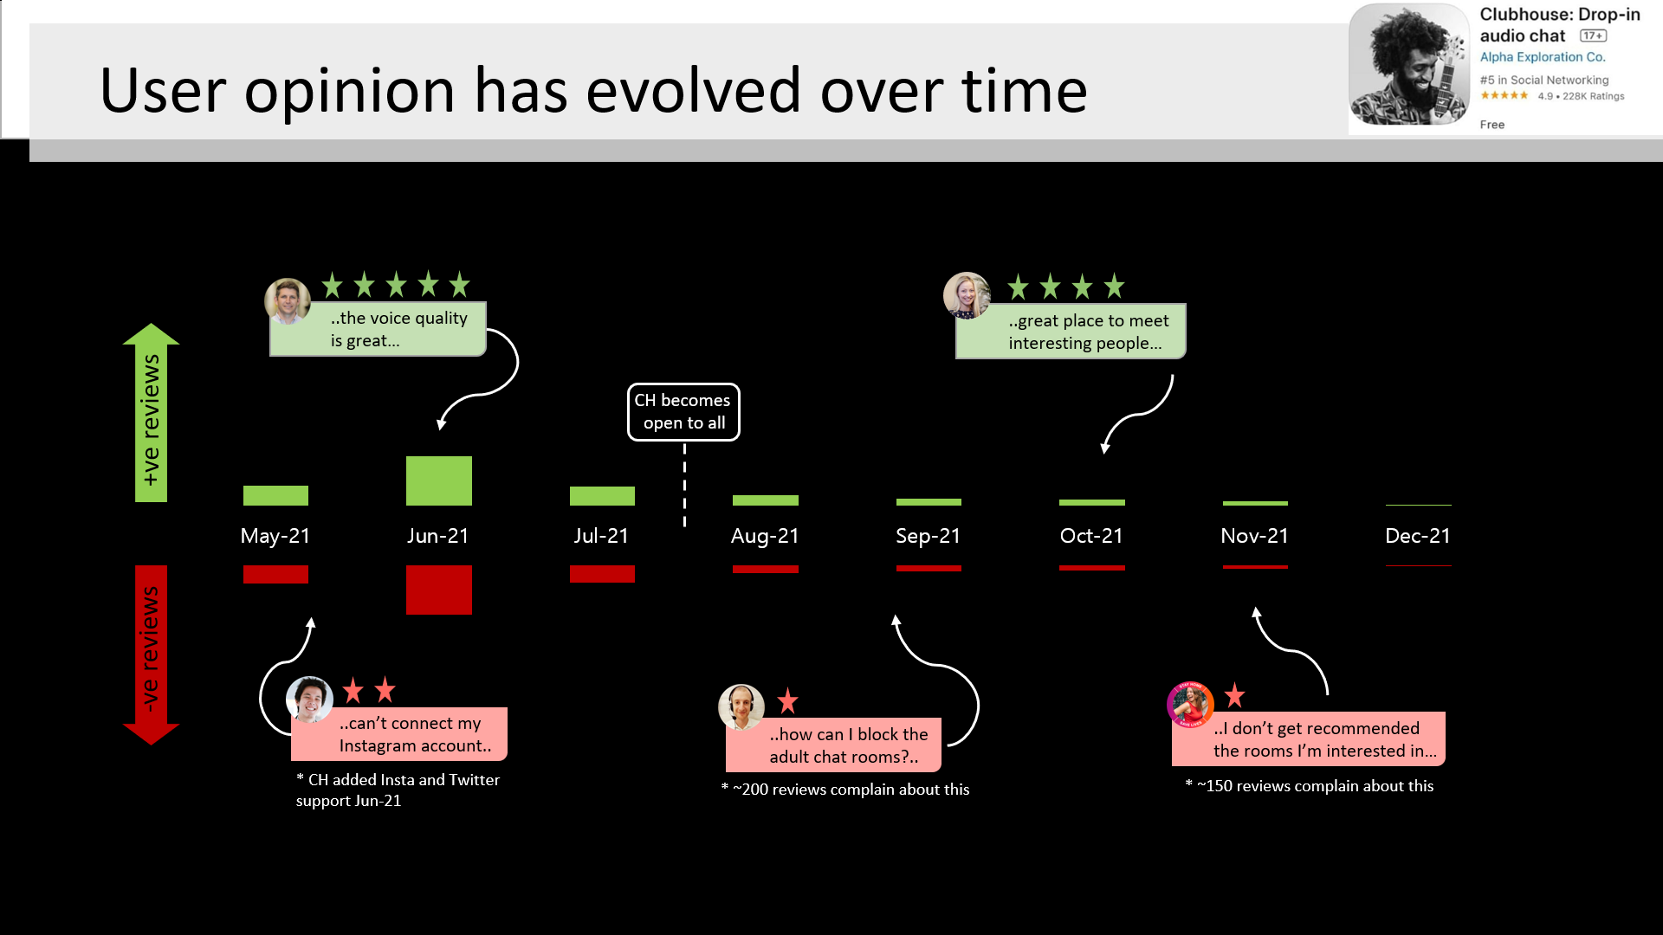

Slide 30
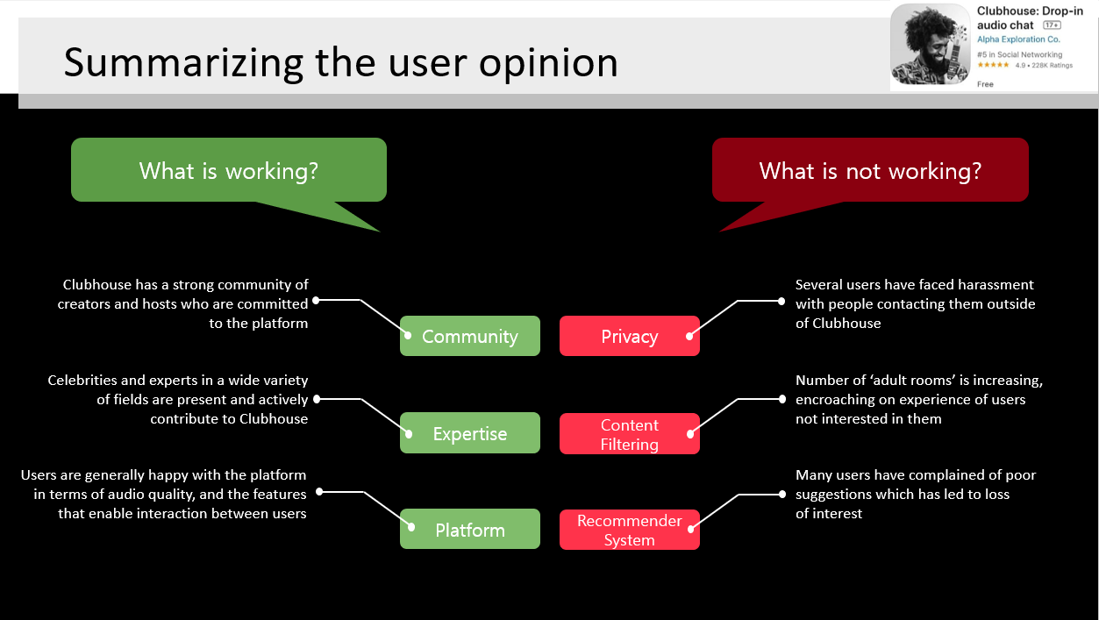

Slide 31
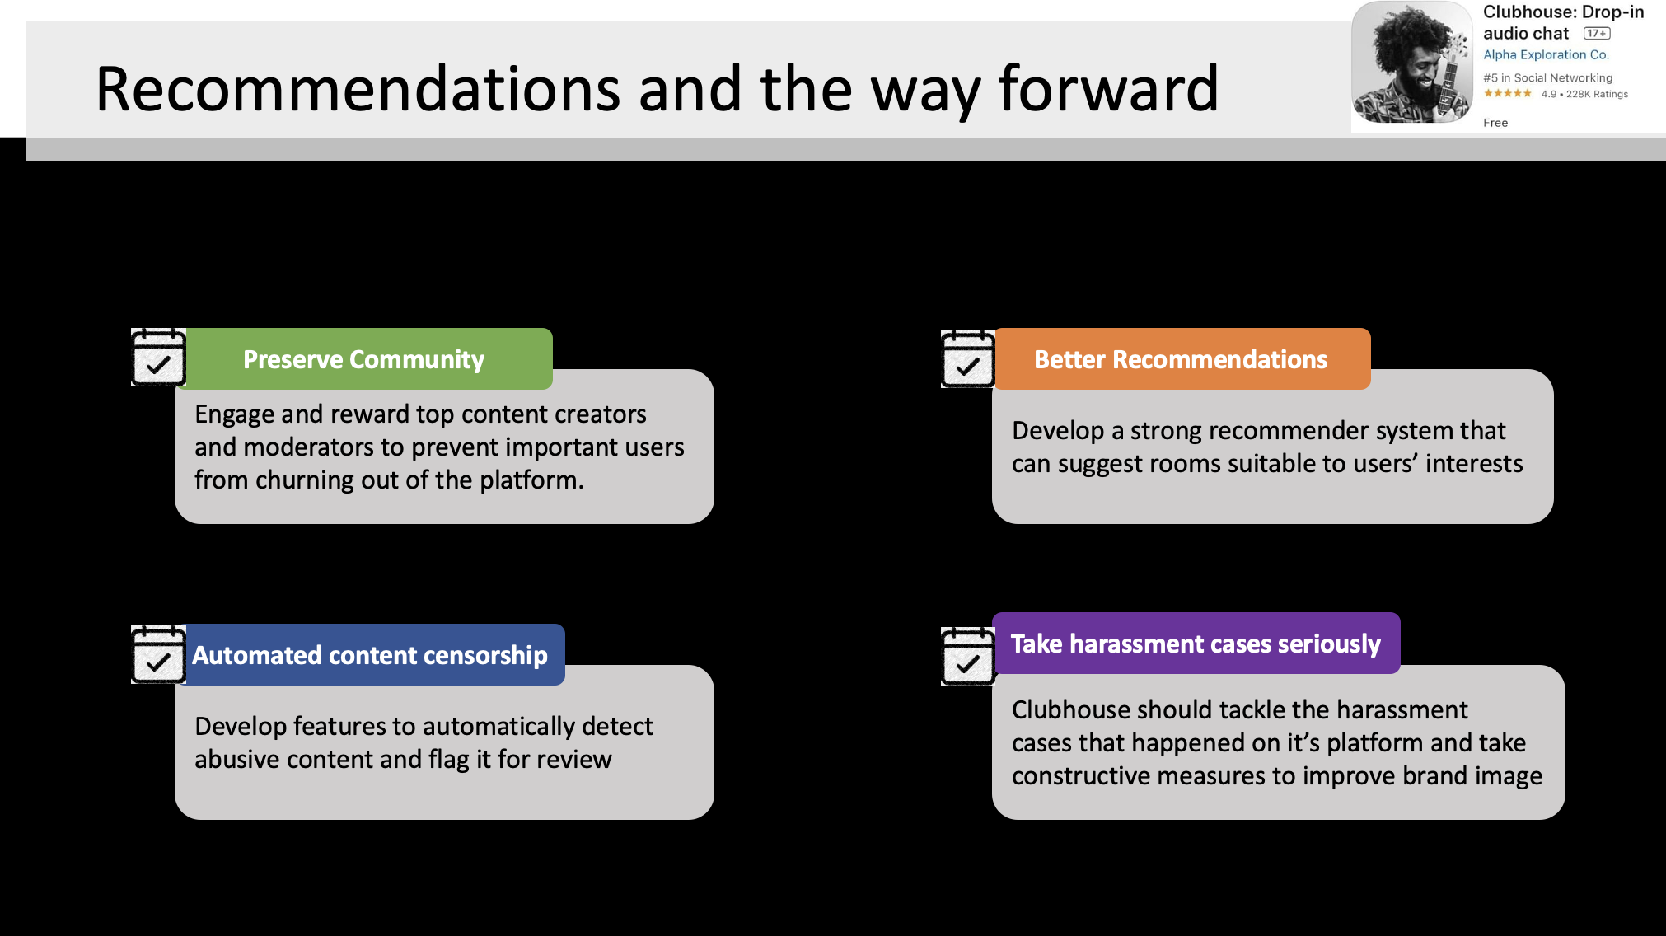

Slide 32
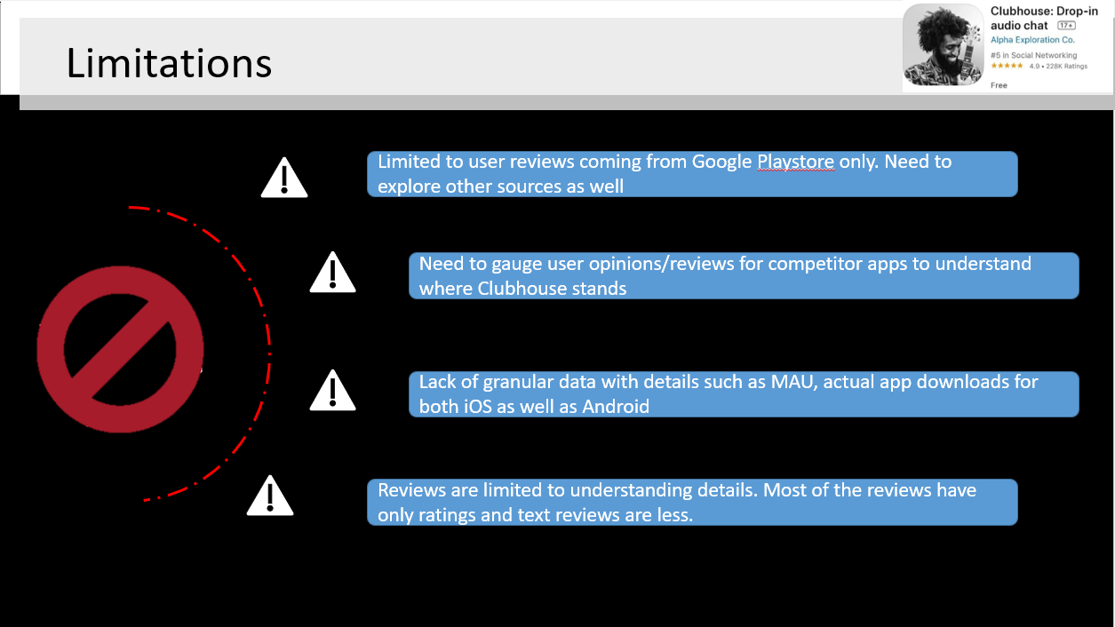

Slide 33
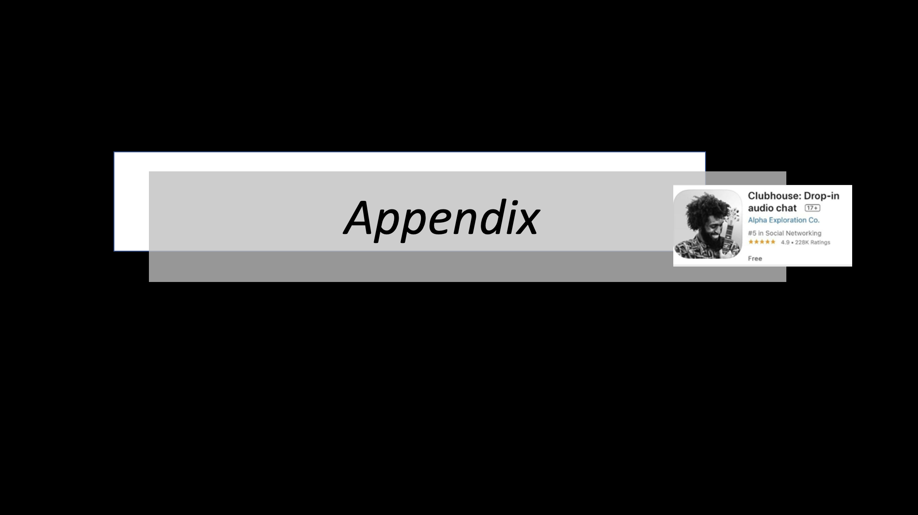

Slide 34
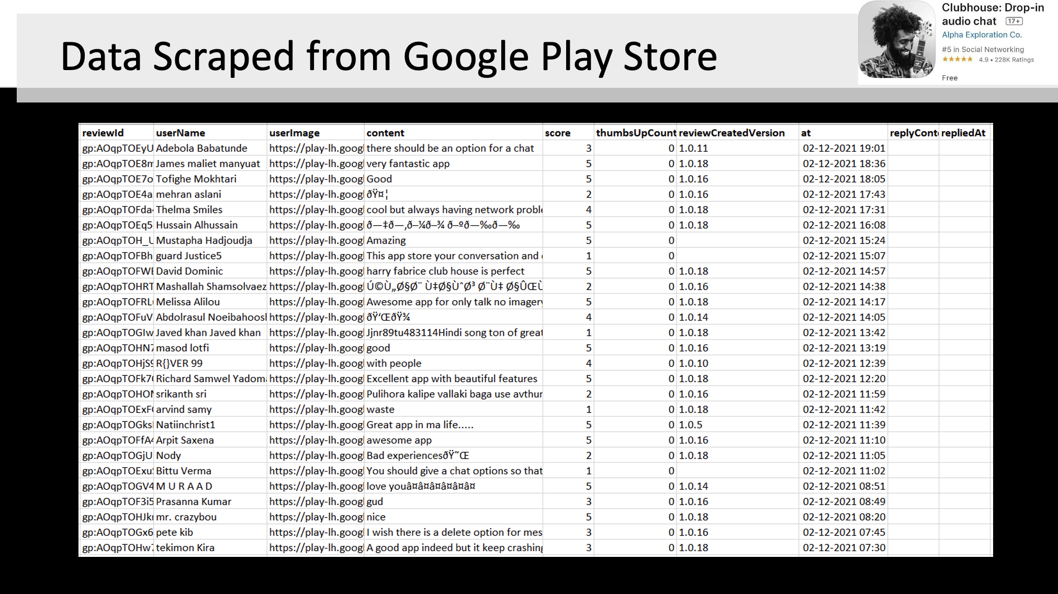

Slide 35
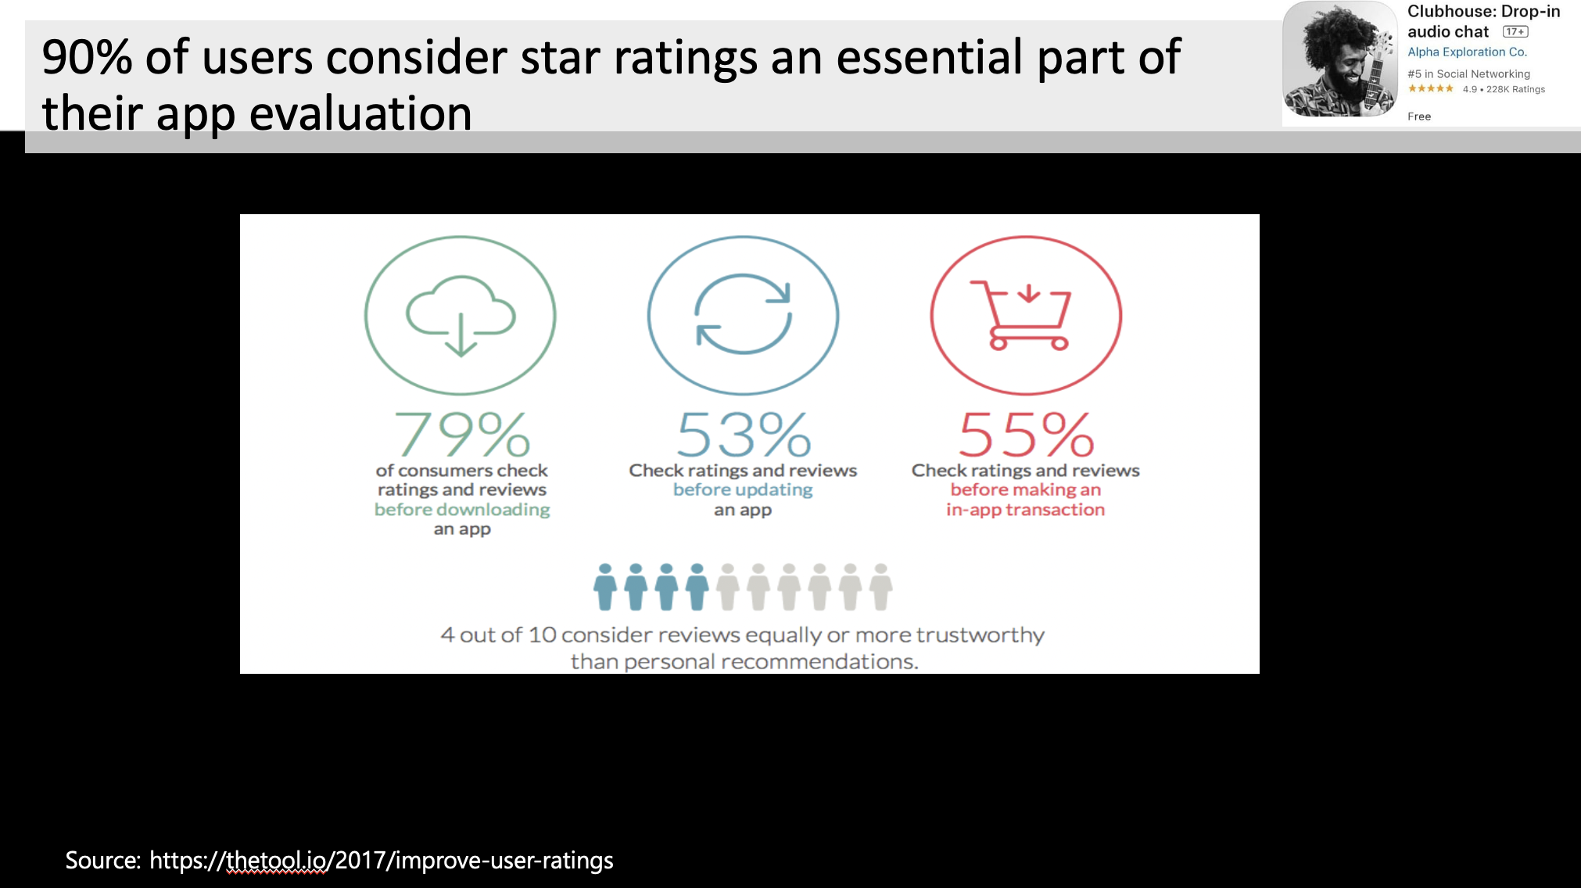

Slide 36
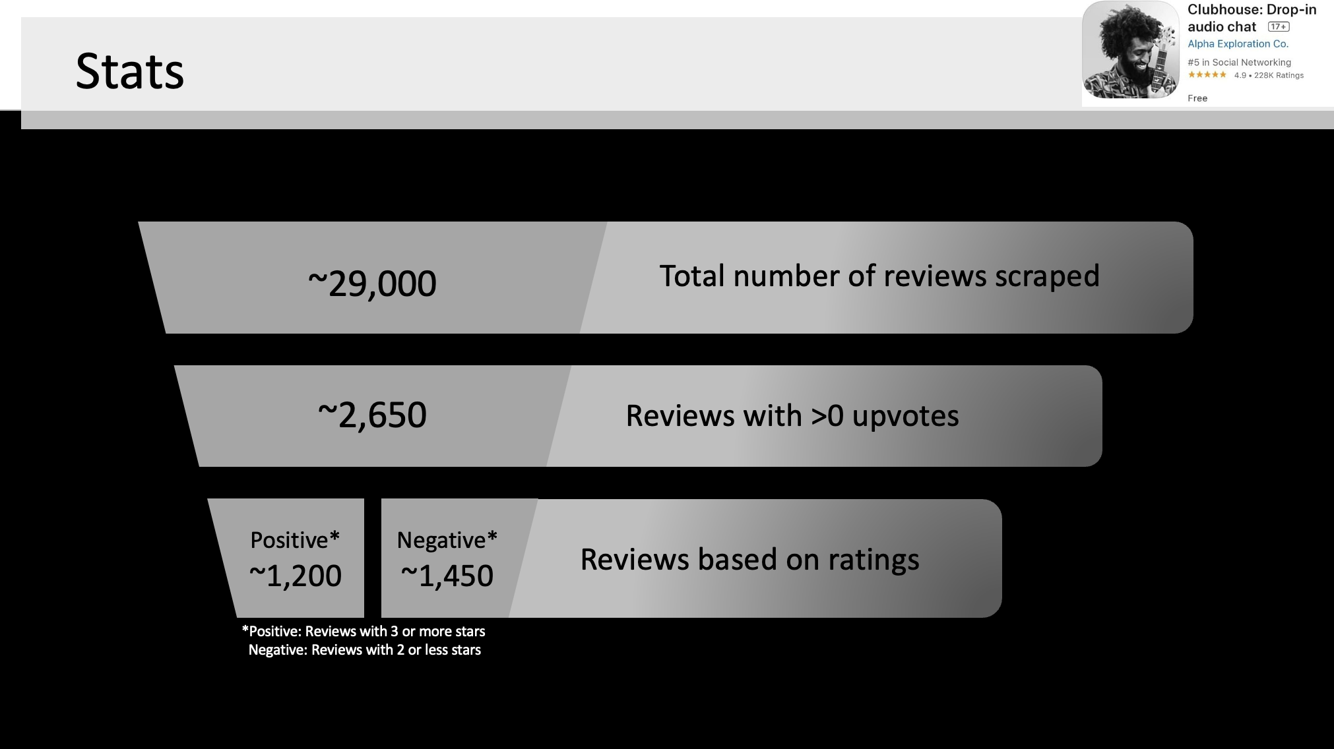

Slide 37
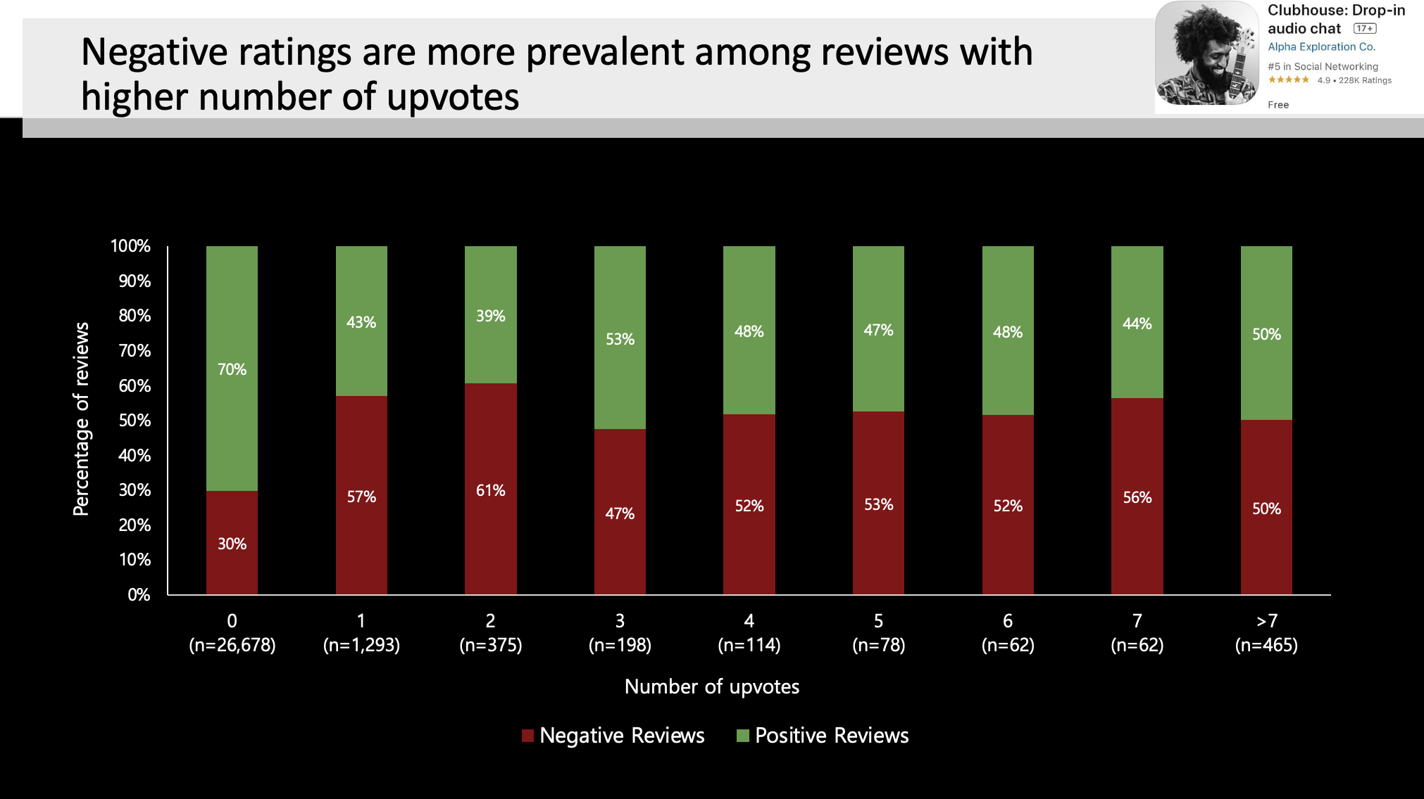

Slide 38
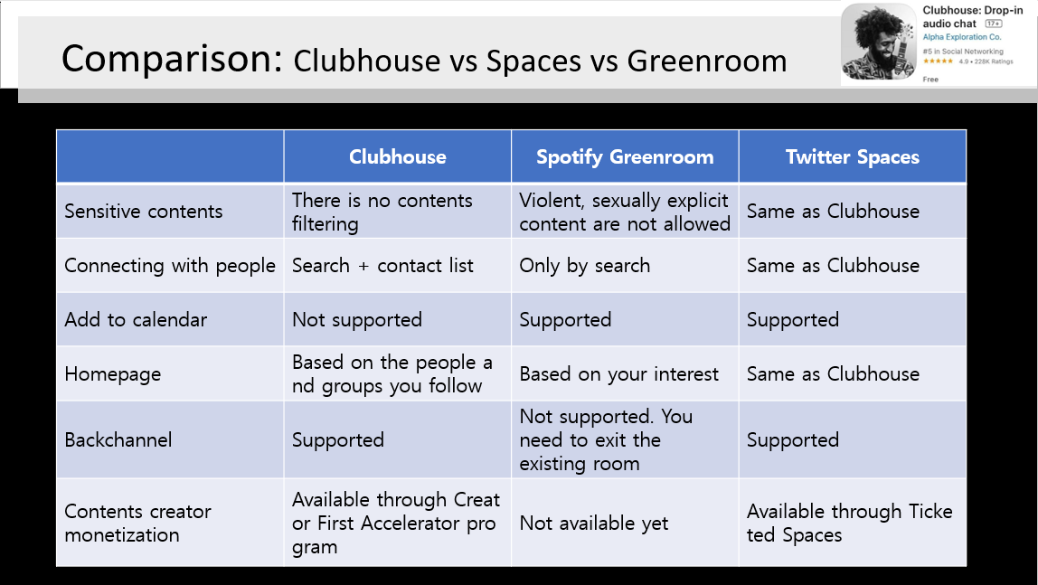

Slide 39
